Slide 1
Classification: Basic Concepts, Decision Trees

Slide 2

Illustrating Classification Learning

Slide 3
Classification Learning Techniques
Decision tree-based methods
Rule-based methods
Instance-based methods
Probability-based methods
Neural networks
Support vector machines
Logic-based methods

Slide 4

Example of a Decision Tree
Refund
Yes
No
NO
MarSt
Single, Divorced
Married
TaxInc
NO
< 80K
> 80K
NO
YES
Training Data
Model: Decision Tree

Slide 5

Apply Model to Test Data
Test Data
Start at the root of tree
Refund
Yes
No
NO
MarSt
Single, Divorced
Married
TaxInc
NO
< 80K
> 80K
NO
YES

Slide 6
Apply Model to Test Data
Test Data
Refund
Yes
No
NO
MarSt
Single, Divorced
Married
TaxInc
NO
< 80K
> 80K
NO
YES

Slide 7

Apply Model to Test Data
Test Data
Refund
Yes
No
NO
MarSt
Single, Divorced
Married
TaxInc
NO
< 80K
> 80K
NO
YES

Slide 8
Apply Model to Test Data
Test Data
Refund
Yes
No
NO
MarSt
Single, Divorced
Married
TaxInc
NO
< 80K
> 80K
NO
YES

Slide 9

Apply Model to Test Data
Test Data
Refund
Yes
No
NO
MarSt
Single, Divorced
Married
TaxInc
NO
< 80K
> 80K
NO
YES

Slide 10
Apply Model to Test Data
Test Data
Refund
Yes
No
NO
MarSt
Single, Divorced
Married
Assign Cheat to “No”
TaxInc
NO
< 80K
> 80K
NO
YES

Slide 11
Decision Tree Learning: ID3
Function ID3(Training-set, Attributes)
  If all elements in Training-set are in same class, then return leaf node labeled with that class
  Else if Attributes is empty, then return leaf node labeled with majority class in Training-set
  Else if Training-Set is empty, then return leaf node labeled with default majority class
  Else
    Select and remove A from Attributes
    Make A the root of the current tree
    For each value V of A
      Create a branch of the current tree labeled by V
      Partition_V ← Elements of Training-set with value V for A
      Induce-Tree(Partition_V, Attributes)
      Attach result to branch V

Slide 12
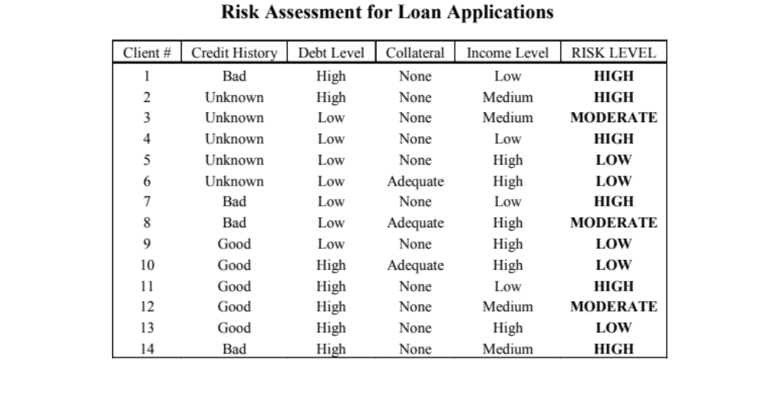
Illustrative Training Set

Slide 13
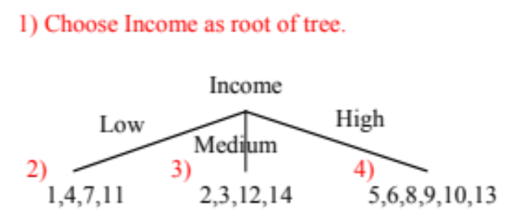
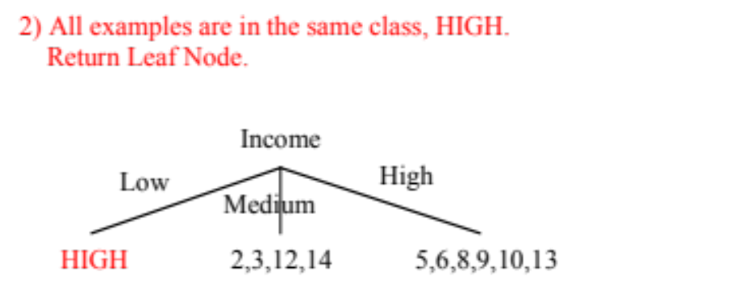
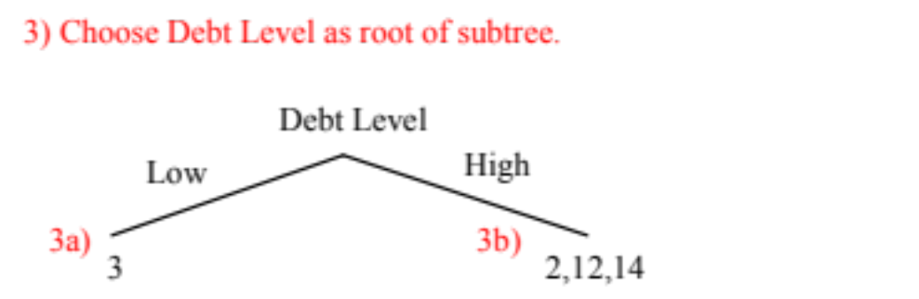
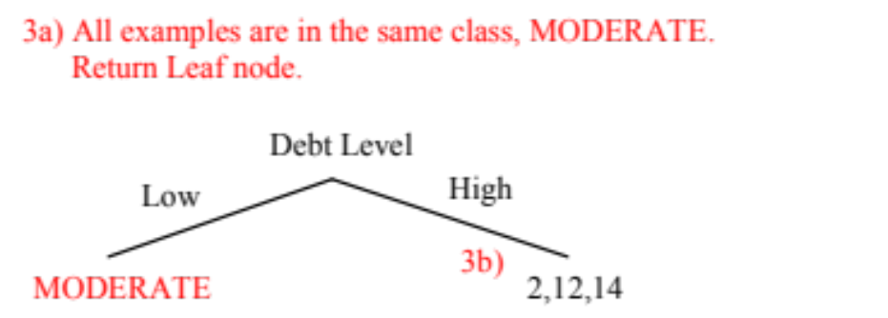
ID3 Example (I)

Slide 14
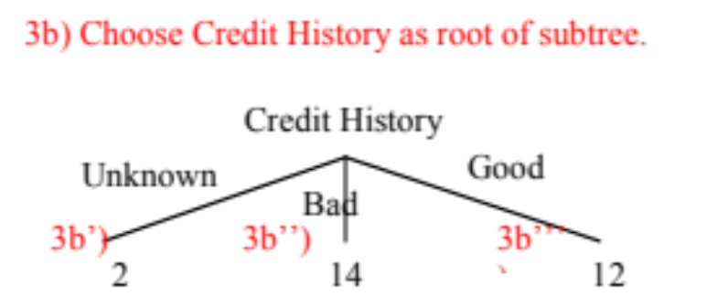
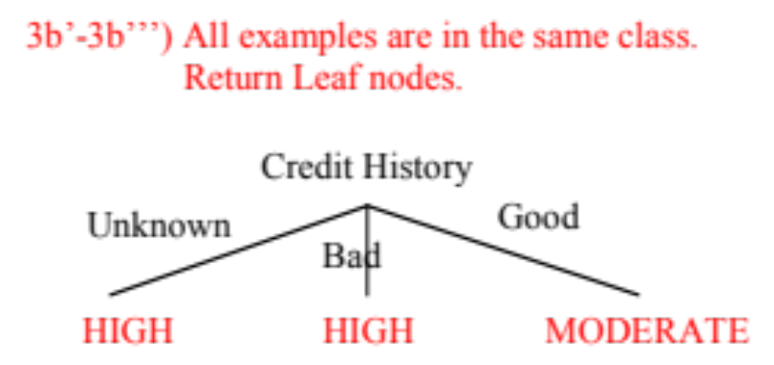
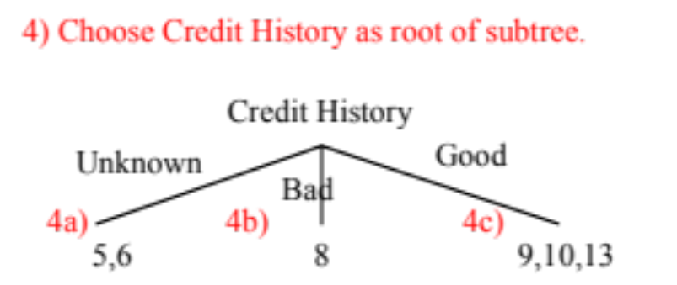
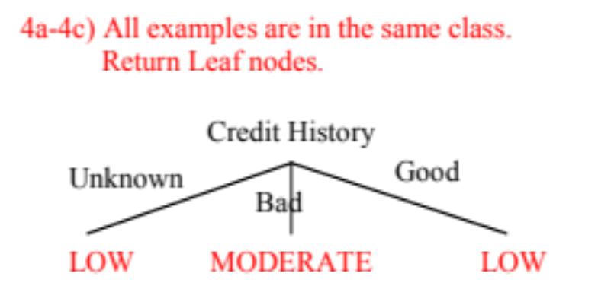
ID3 Example (II)

Slide 15
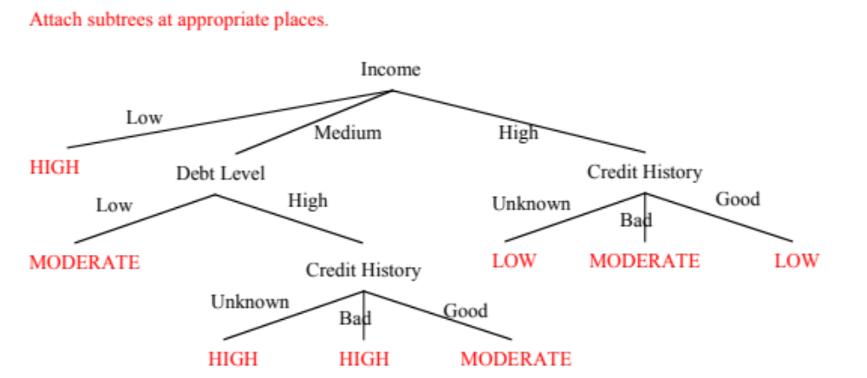
ID3 Example (III)

Slide 16
Non-Uniqueness
Decision trees are not unique:
  Given a set of training instances T, there generally exists a number of decision trees that are consistent with (or fit) T
MarSt
Single, Divorced
Married
NO
Refund
Yes
No
NO
TaxInc
< 80K
> 80K
NO
YES

Slide 17
ID3’s Question
Given a training set, which of all of the decision trees consistent with that training set should we pick?
More precisely:
Given a training set, which of all of the decision trees consistent with that training set has the greatest likelihood of correctly classifying unseen instances of the population?

Slide 18
ID3’s Question Revisited
Since ID3 builds a decision tree by recursively selecting attributes and splitting the training data based on the values of these attributes
Practically:
Given a training set, how do we select attributes so that the resulting tree is as small as possible, i.e. contains as few attributes as possible?

Slide 19

Entropy (as information)
Entropy at a given node t:
    (where p( j | t) is the relative frequency of class j at node t)
Based on Shannon’s information theory
  For simplicity, assume only 2 classes Yes and No
  Assume t is a set of messages sent to a receiver that must guess their class
    If p( Yes | t )=1 (resp., p( No | t )=1), then the receiver guesses a new example as Yes (resp., No). No message need be sent.
    If p( Yes | t )=p( No | t )=0.5, then the receiver cannot guess and must be told the class of a new example. A 1-bit message must be sent.
    If 0<p( Yes | t )<1, then the receiver needs less than 1 bit on average to know the class of a new example.

Slide 20
Entropy (as homogeneity)
Think chemistry/physics
  Entropy is measure of disorder or homogeneity
  Minimum (0.0) when homogeneous / perfect order
  Maximum (1.0, in general log C) when most heterogeneous / complete chaos
In ID3
  Minimum (0.0) when all records belong to one class, implying most information
  Maximum (log C) when records are equally distributed among all classes, implying least information
  Intuitively, the smaller the entropy the purer the partition

Slide 21




Examples of Computing Entropy
P(C1) = 0/6 = 0 P(C2) = 6/6 = 1
Entropy = – 0 log 0 – 1 log 1 = – 0 – 0 = 0
P(C1) = 1/6 P(C2) = 5/6
Entropy = – (1/6) log₂ (1/6) – (5/6) log₂ (1/6) = 0.65
P(C1) = 2/6 P(C2) = 4/6
Entropy = – (2/6) log₂ (2/6) – (4/6) log₂ (4/6) = 0.92

Slide 22

Information Gain
Information Gain:
    (where parent Node, p is split into k partitions, and
    n_{i} is number of records in partition i)
  Measures reduction in entropy achieved because of the split ➔ maximize
  ID3 chooses to split on the attribute that results in the largest reduction, i.e, (maximizes GAIN)
  Disadvantage: Tends to prefer splits that result in large number of partitions, each being small but pure.

Slide 23





Computing Gain
Before Splitting:
E0
A?
B?
Yes
No
Yes
No
Node N1
Node N2
Node N3
Node N4
E1
E2
E3
E4
E12
E34
Gain = E0 – E12 vs. E0 – E34

Slide 24


Gain Ratio
Gain Ratio:
    (where parent Node, p is split into k partitions, and
    n_{i} is number of records in partition i)
  Designed to overcome the disadvantage of GAIN
  Adjusts GAIN by the entropy of the partitioning (SplitINFO)
  Higher entropy partitioning (large number of small partitions) is penalized
  Used by C4.5 (an extension of ID3)

Slide 25

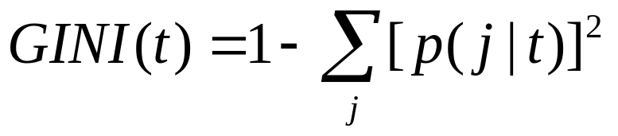
Other Splitting Criterion: GINI Index
GINI Index for a given node t :
  Maximum (1 - 1/n_{c}) when records are equally distributed among all classes, implying least interesting information
  Minimum (0.0) when all records belong to one class, implying most interesting information
  Minimize GINI split value
  Used by CART, SLIQ, SPRINT

